Slide 1



A brief analysis of the careers of two widely loved, lampooned, and memed actors:
Nicolas Cage and Kevin Bacon
Project By Tamara Newman, Ben Rowland, and Tatiana Tarasova
Also known as team Gamma

Slide 2
Welcome to the Ultimate Hollywood Grudge-Match!!!
Agenda
Data Collection & Cleansing
Database Building
SQL Query
Problems
Data Analysis
Data Visualization
Closing
Q&A

Slide 3
Problem Statement
Using techniques learned in our data analytics bootcamp, can we make a definitive argument for which of our two chosen actors has had the most successful career up to now?
Key Objectives
To make this determination we're focusing on two key metrics, box office earnings and movie ratings to illustrate:
Which actor had the most hit movies?
Top Rated
Top Earning
Which actor's movies earned the most?
Domestically
Internationally
Worldwide

Slide 4






Tools
We used Excel to do some data cleaning, DB Browser to build a SQLlite database, Python to reformat and analyze the data, PowerBI to visualize the data. Last but not least we used Github to collaborate and store the data.

Slide 5
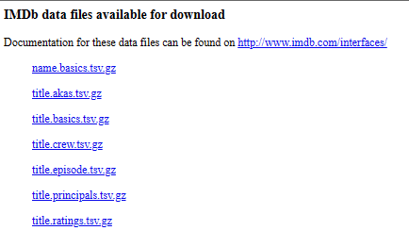

Data Collection
We started with a baseline dataset provided by the Internet Movie Database (IMDb). This large dataset is made available for download as seven separate tables in a compressed file format, which are updated daily with the latest data, and can be utilized individually or as part of a larger relational database.
As comprehensive as the IMDb dataset is, they do not provide box office data to users without significant cost, so we needed to find an alternative data source.

Slide 6
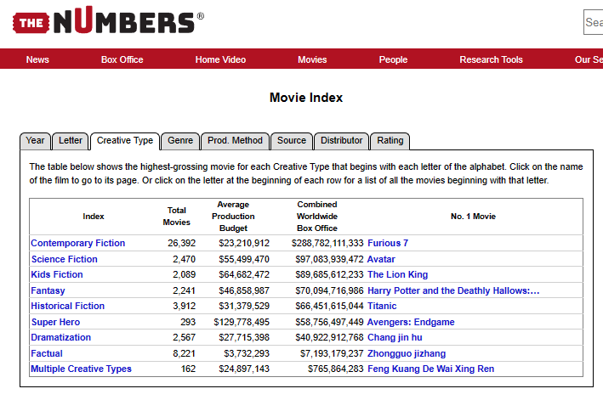
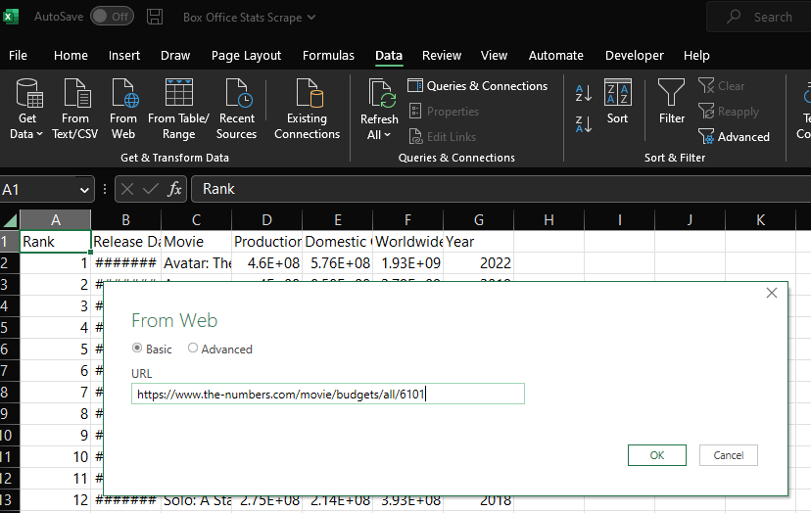
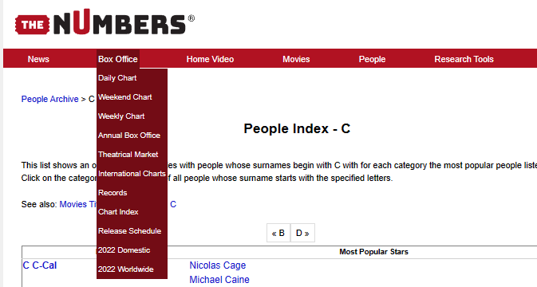
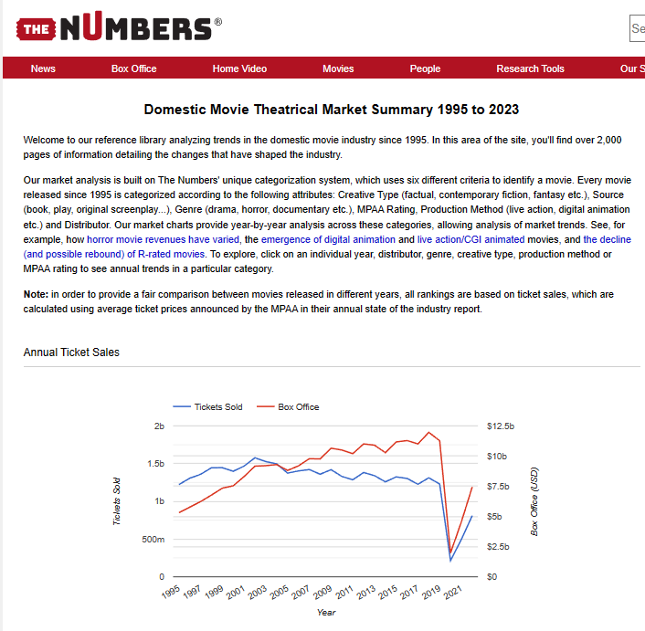
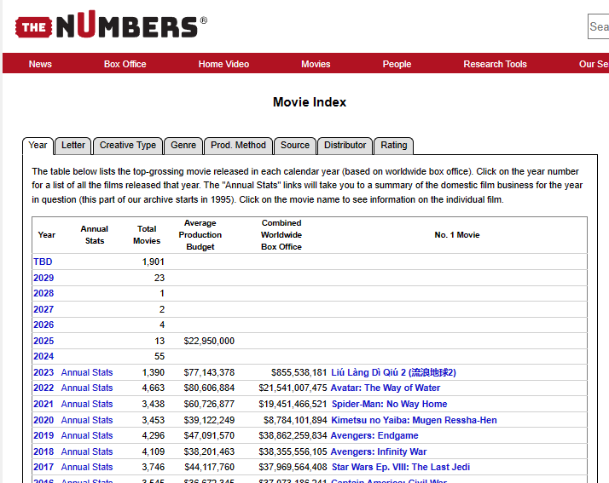
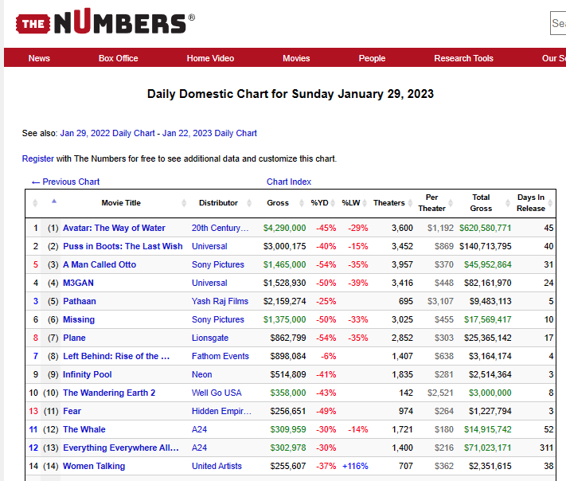

Data Collection
A website called the-numbers.com has extensive box office data, but since they also monetize this data, they do not make it freely available for download. In this case we had to manually "scrape" the data, which this site tries to prevent by only showing 100 entries at a time, at most.
Process: Using Excel's Get & Transform Data From Web function we used the source data URL and iterated it by 100 each time to collect the maximum amount of data allowed, which generated 64 individual Excel sheets of data.

Slide 7


Data Cleansing and Formatting
After scraping the data, we combined the 100 row tables generated by the "From Web" Excel function into a single table, then converted it from a standard Excel Worksheet (.xlsx) to the Comma Separated Value (.csv) format so we could import the file into DB Browser to build our database. The IMDb data needed to be decompressed, but the resulting Tab Separated Value format was already compatible with DB Browser.

Slide 8
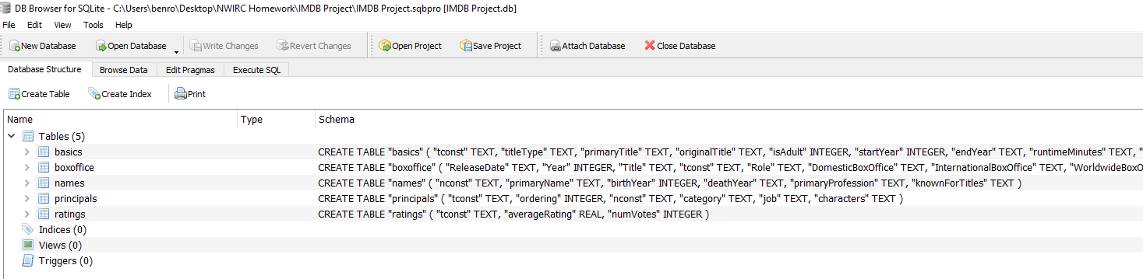
Database Building
With our data collected and properly formatted, we began to import it into DB Browser, the SQLite tool selected to manipulate our data in SQL and create a new database for further analysis in Orange and PowerBI. The import process varies from format to format, so we needed to specify which files were tab (.tsv) or comma (.csv) delimited.

Slide 9
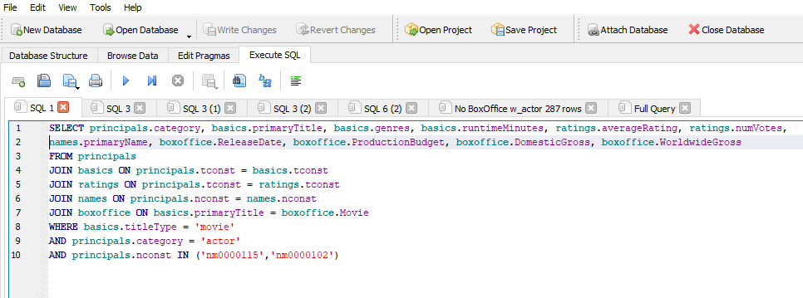
SQL Query
Based on the objectives of our project, we knew what data we needed, and despite importing 8 tables, we were only going to need 5. Our query was intended to join data from five tables and two sources, using constructor values for one source, and common values (movie title) to join the other. Our desired output was a complete list of movies that Nicolas Cage and Kevin Bacon had each been in, with category, genre, ratings, and box office earnings for each.

Slide 10
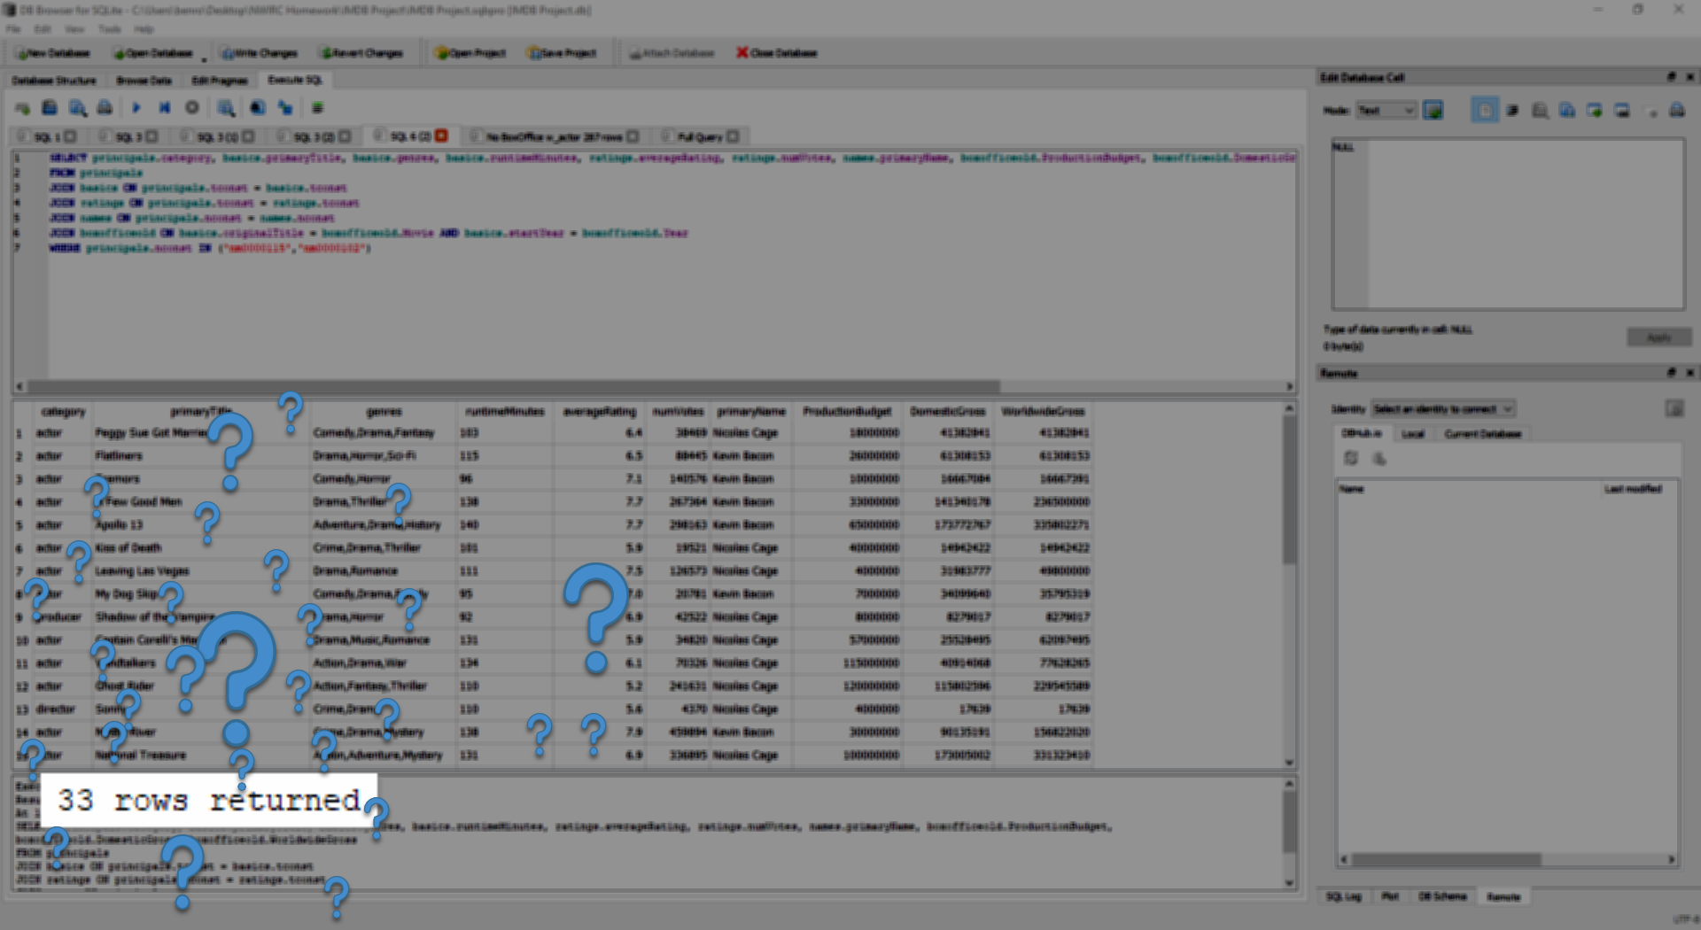
Query Problems
Our first query attempt gave us poor results, leaving us with only 33 rows of data to work with. Knowing each actor has over 100 titles to their credit made it obvious we made an error, but ascertaining the cause of our poor data was very difficult because we wrote the query all in one go. This meant that we couldn't be sure which part of the query was causing the problem, so we had to rebuild it, one element at a time, making sure each part was yielding the correct data, before moving to the next element. This quickly led us to the culprit – bad data.

Slide 11
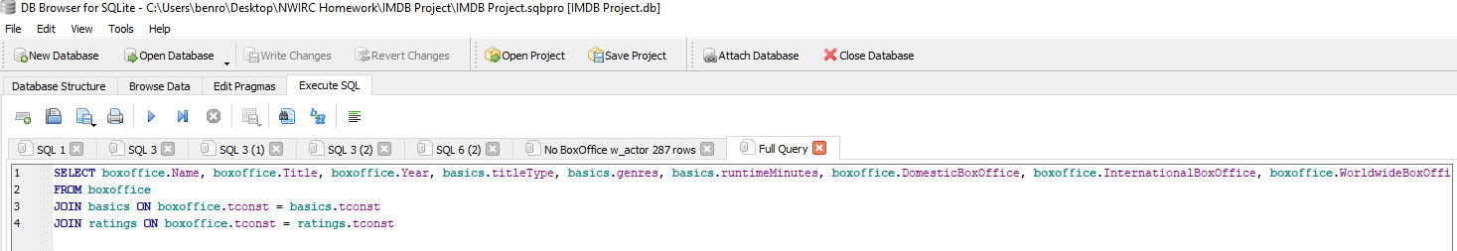
Data Problems
!=
We assumed the data we scraped was a comprehensive list of movies, comparable to the IMDb data, with perhaps some inconsistencies in the title here and there. This was a very bad assumption and cost us valuable time on this project. We pivoted to new box office data from the same source that was confirmed to include all the titles we needed, and we manually cleansed the title data to ensure 100% accuracy and alignment with IMDb title data. This was the constructor we used to join data from the disparate sources in SQL, which allowed us to write a much shorter and more precise query, giving us the dataset we needed for our analysis.

Slide 12

Data Analysis
Once we had our query output, we loaded the CSV into Orange for analysis. We used both Principal Component Analysis (PCA) and Scatter Plots to look for trends and patterns in our data.

Slide 13
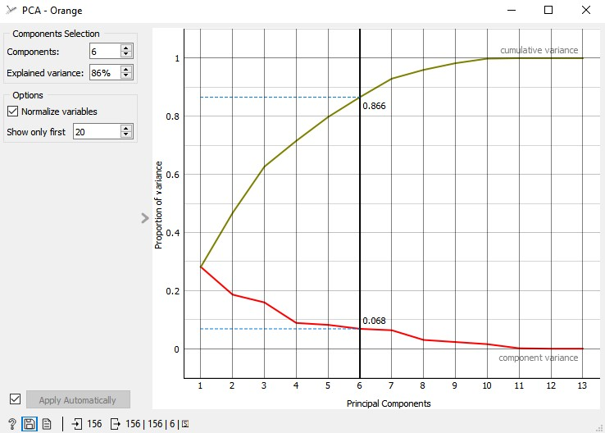
Data Analysis – PCA
We ran a Principal Component Analysis (PCA) in Orange and found a lot of correlation in our variables which allowed us to reduce the dimensionality by about half and still retain more than 80% of the information necessary to identify patterns in the data.
We

Slide 14
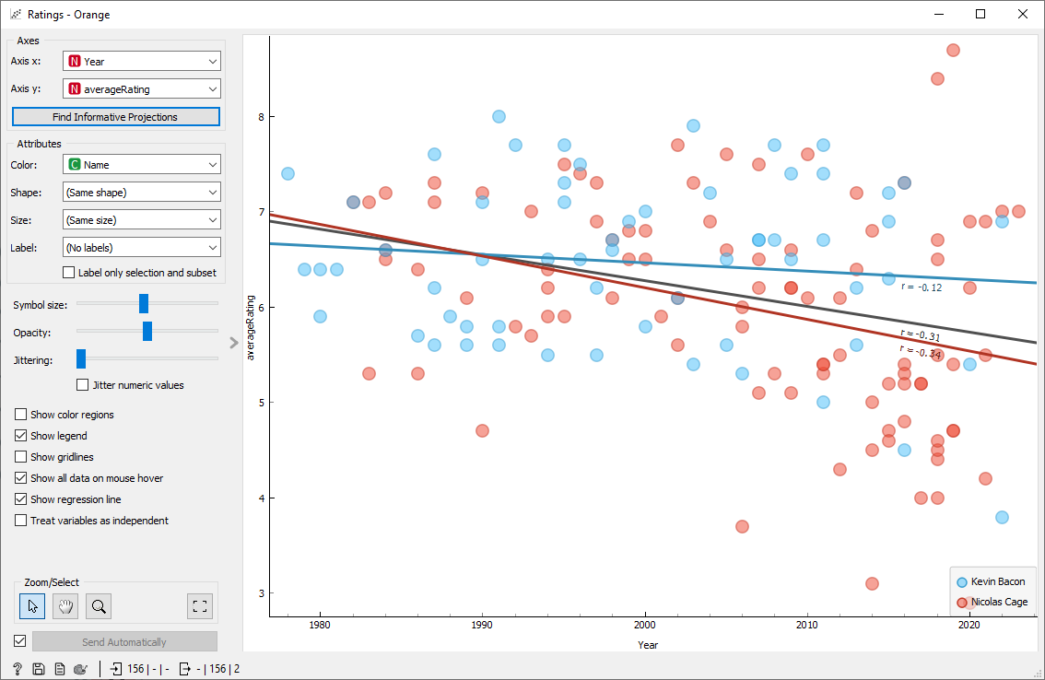
Data Analysis – Scatter Plot
Scatter Plot – Average Rating by Year
Our data shows that both actors have had an overall downward trend in the ratings of their movies, worse for Nic Cage (r = -0.34) but still not great for Kevin Bacon (r = -0.12).

Slide 15
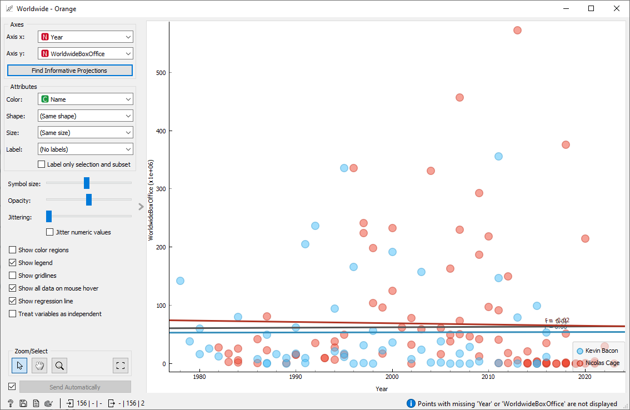
Data Analysis – Scatter Plot
Scatter Plot – Worldwide Box Office by Year
While Kevin Bacon’s movies have a completely flat trend overall for Worldwide Box Office earnings (r = 0.0), but there’s a slight decline for Nicolas Cage (r = -0.2).

Slide 16
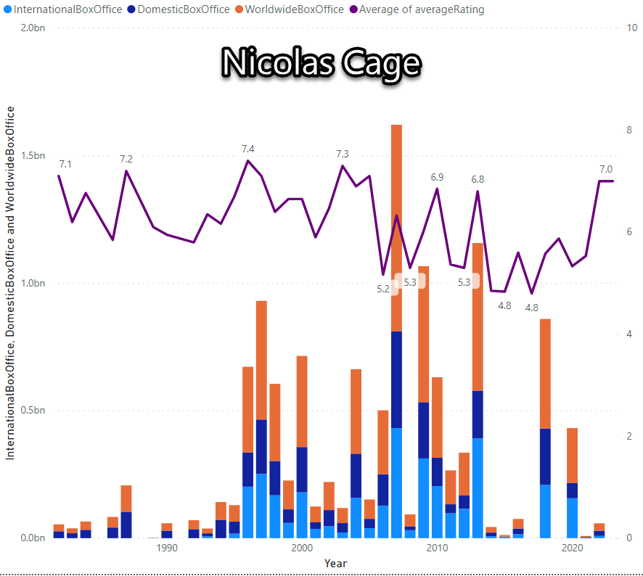
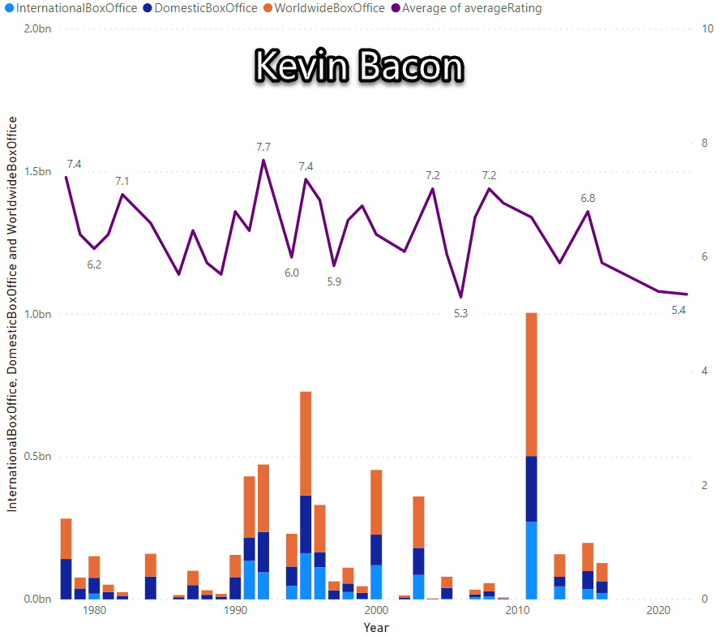
Comparison Visualization #1
Box Office totals by year with average rating per year – could go either way.

Slide 17
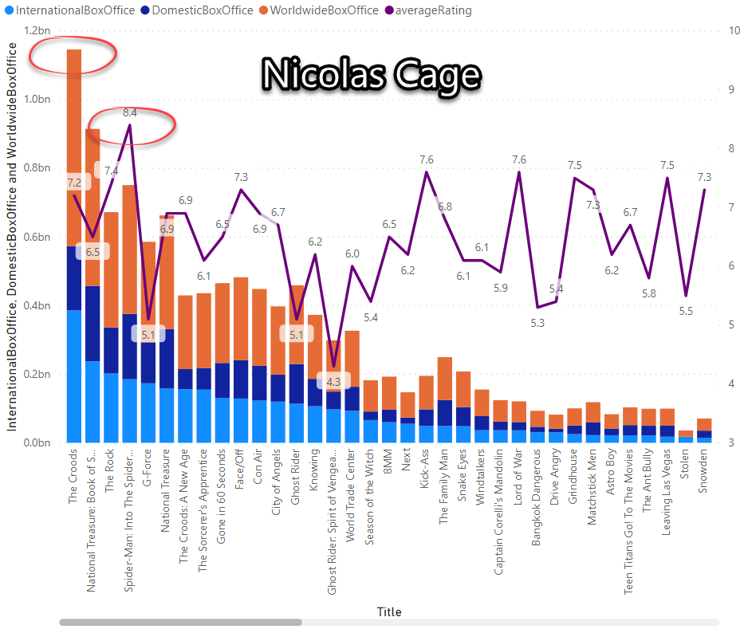
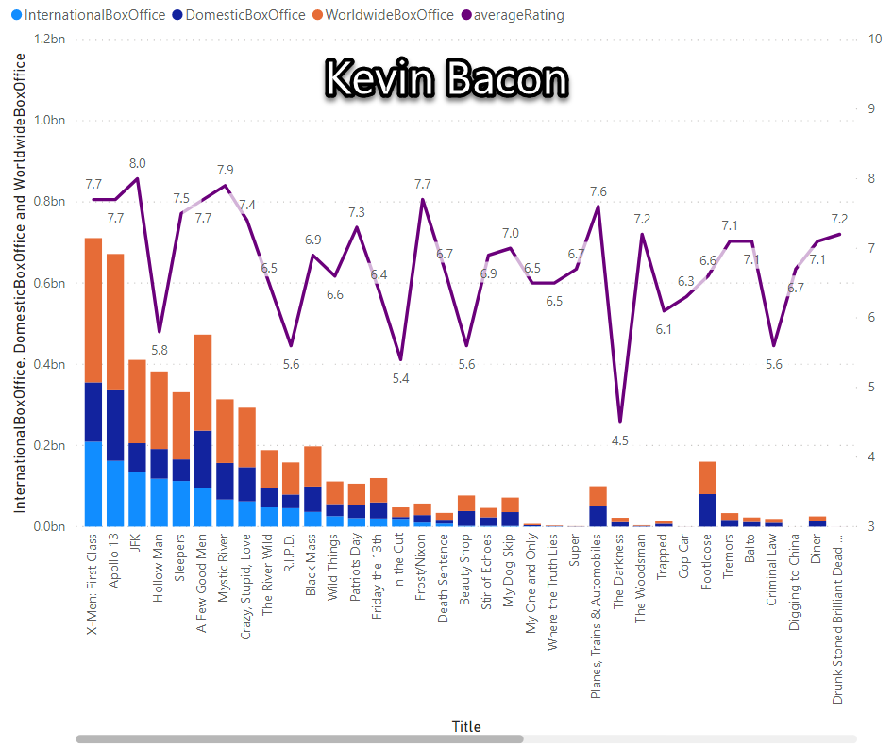
Comparison Visualization #2
Box Office totals by movie with individual rating – both categories go to Nicolas Cage.

Slide 18
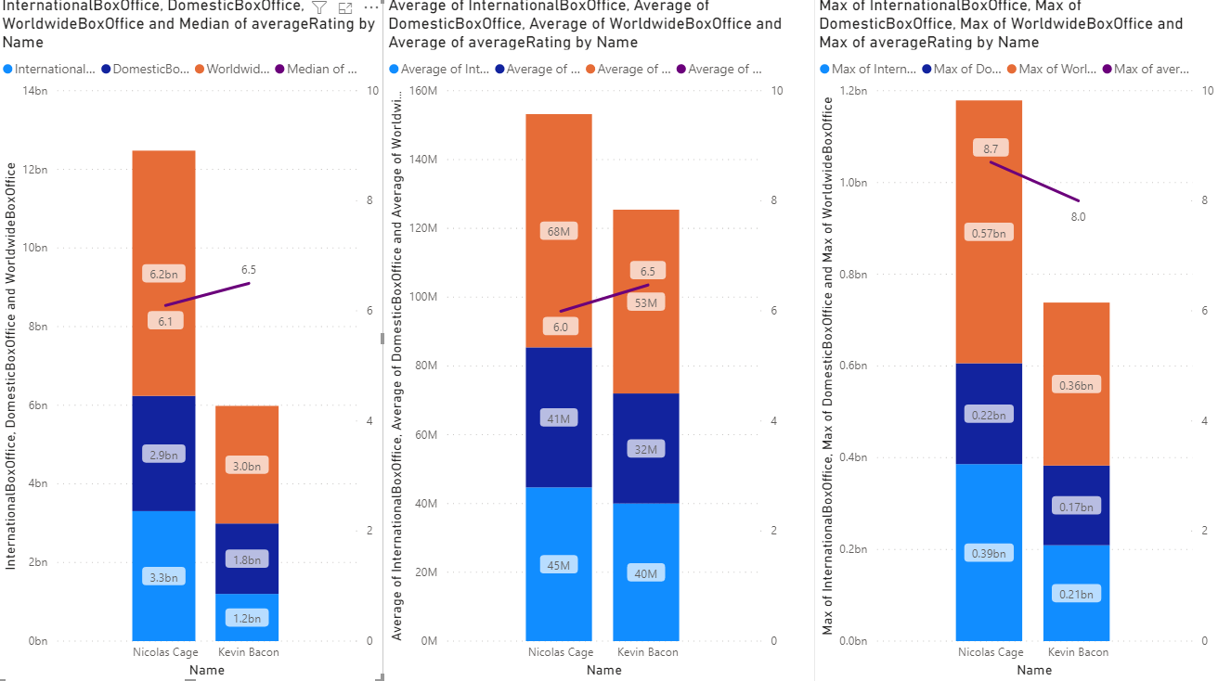
Comparison Visualization #3
All-time box-office totals with median all-time rating – 50/50 split
Average box-office totals with average all time rating – 50/50 split
Highest all-time box-office totals with highest all-time rating – Nicolas Cage

Slide 19
Results
WINNER!
Not the winner…

Slide 20

Github Repository
https://github.com/Redheadedtam/Team-Project.git
The link above is where you can find our project.
GitHub is a code hosting platform for version control and collaboration. It lets you and others work together on projects from anywhere.

Slide 21
Summary and Closing
We started this project with an ambitious topic, but as we struggled with our data, our options for analysis and complexity evaporated, leaving us with a relatively simplistic comparative analysis. We intended to explore possible correlation between whether starring in movies with Nicolas Cage or Kevin Bacon would cause an upward or downward trend in an actor’s career but ran out of time.
Based on our analysis of box office and ratings data we found that Nicolas Cage is the higher earning actor, both on average and overall. While Kevin Bacon has a higher average rating overall, none of his movies have soared to the heights that Nicolas Cage’s have. So, to answer our initial question, Nicolas Cage has had the more successful career based on our parameters.
It’s a shame that we had so much trouble with our data, forcing us to severely limit our data set and the scope of our exploration, but that appears to be the nature of data and you just have to do what you can with what you have.
We used most of the tools and some of the methods learned over the course of this bootcamp to collect, cleanse, and analyze our data then present it to you here. SQL joins proved to be our biggest hurdle, and I think we all wish we had more time to brush up on our Orange skills to possibly produce more compelling analysis, but based on what we found, we recommend:
If you want a shot at making top dollar for your films go with Nicolas Cage, though it does come with some risk.
If you want higher ratings, then you’re more likely to get that with Kevin Bacon.
If you want to target international audiences over domestic audiences, Kevin Bacon is your man.
If you want to break the internet, then turn this project into a screenplay and put them both in that movie.
Thank you for your time and consideration, we appreciate your participation and input!
-Team Gamma

